Slide 1
Stop the Spread Quest
Start Here
on your Journey to become the first
Alien Thwarter!

Slide 2
Just Chilling
Stop the Spread Quest
Wait for your next roll of the dice

Slide 3
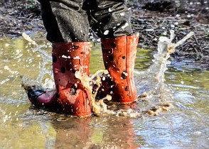
You forget to wash your boots!
Stop the Spread Quest
Miss a go!

Slide 4
You remember to clean your wellies, gear and dog to remove the seeds and mud before getting in the car.
Stop the Spread Quest
Move on 3 places

Slide 5
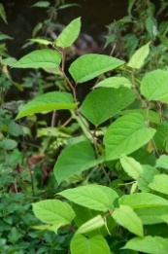
You strim some plants in your garden – they were the invasive Japanese Knotweed so you have spread it further!
Stop the Spread Quest
Miss a go!
Crown copyright: GBNNSS

Slide 6
Just Chilling
Stop the Spread Quest
Wait for your next roll of the dice

Slide 7
Just Chilling
Stop the Spread Quest
Wait for your next roll of the dice

Slide 8
You accept an unknown plant from a friend. It might not be a native variety!
Stop the Spread Quest
?
?
?
Dailyclipart.net
Go back 2 spaces and wait for your next throw.

Slide 9
Just Chilling
Stop the Spread Quest
Wait for your next roll of the dice

Slide 10
Just Chilling
Stop the Spread Quest
Wait for your next roll of the dice

Slide 11
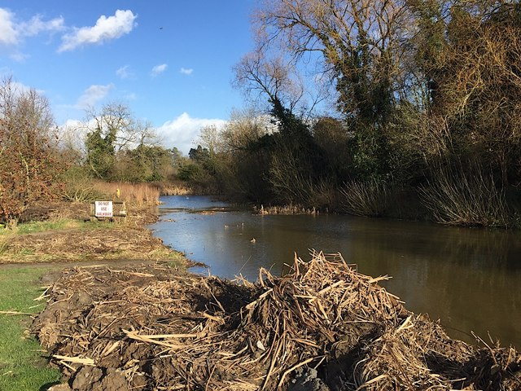
You clean out an old pond, leave the old plants to dry out then compost them.
Stop the Spread Quest
Photo: Robin Stott
Move on 2 places

Slide 12
Just Chilling
Stop the Spread Quest
Wait for your next roll of the dice

Slide 13
Just Chilling
Stop the Spread Quest
Wait for your next roll of the dice

Slide 14
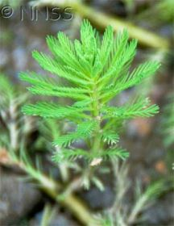
You clear out an old pond and dump the plants in a nearby lake (You just spread the invasive plant - parrots feather too!)
Stop the Spread Quest
Crown copyright: GBNNSS
Go back 1 space and wait for your next throw.

Slide 15
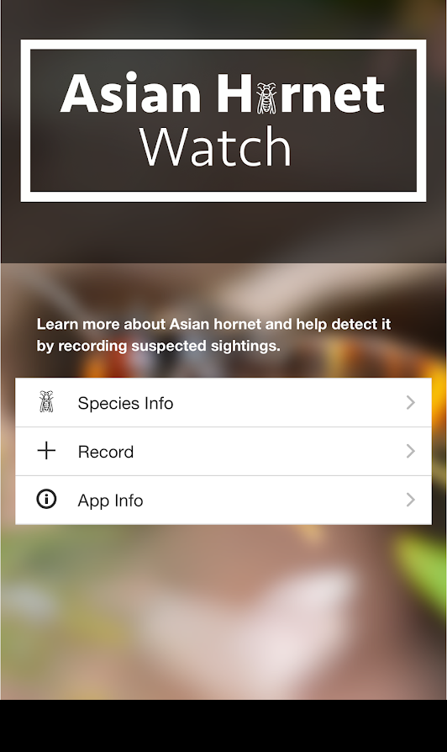
You find an very aggressive wasps nest and report it to the Asian Hornet Watch app.
Stop the Spread Quest
Move on 2 places

Slide 16
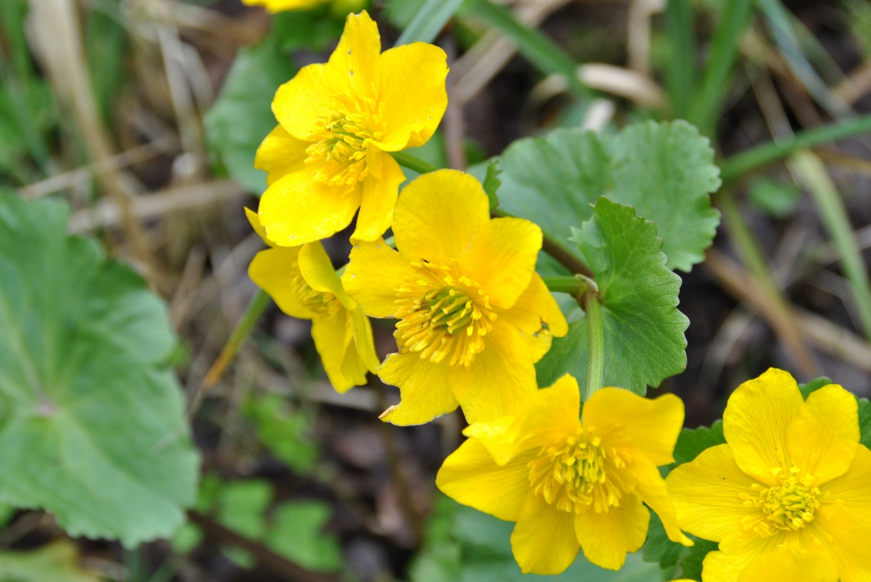
You checked that the aquatic plants that you bought were native plants.
Stop the Spread Quest
Dipti Patel
Move on 1 place

Slide 17
Just Chilling
Stop the Spread Quest
Wait for your next roll of the dice

Slide 18
Just Chilling
Stop the Spread Quest
Wait for your next roll of the dice

Slide 19
You forget to wash your boots!
Stop the Spread Quest
Miss a go!

Slide 20
Stop the Spread Quest
Congratulations
you are the
Alien Thwarter!

